Slide 1
Learn to Code Part IV
JavaScript
CodeSLO 2018

Slide 2
Clone Today’s Files
In VS Code open the console with cmd + ~ or ctrl + ~
In the VS code console, enter the following command:
git clone https://github.com/codeslo/learn-to-code-04 <foldername>
Change <foldername> to be whatever you’d like your new folder to be called. Learn-to-code-04 might be a good name.

Slide 3
What is JavaScript?
JavaScript is a programming language. It is the only programming language that web browsers understand.
JavaScript is an interpreted language, which means it is written in text files that are interpreted by the browser.
By itself, a JavaScript text file doesn’t do anything. It needs an interpreter to make it work.
Because it is used by all web browsers, JavaScript is the most often used programming language in the world.

Slide 4
What do we do with JavaScript?
JavaScript allows us to move beyond static web pages and into web applications.
With JavaScript we can accept user input, communicate with web servers, run calculations on data, and much more.
JavaScript is used to create everything from email applications (gmail) to music playing applications (Pandora, Spotify) to video games (HexGL, Sketchout, Bejeweled.)

Slide 5
So JavaScript can only be used on webpages?
Not anymore. JavaScript was originally limited to front-end (client side) applications on web pages but now, with frameworks like Node.js, React, and Electron JavaScript can be used for mobile applications, server side applications, desktop applications, and even things like robotics and IoT devices.
The future of JavaScript is very bright.

Slide 6
Why JavaScript is hard
There’s a lot you can do with it. Where HTML and CSS each have only one job, JavaScript is an all-purpose tool. It can do almost anything you want, so long as you know how to write the code. With that power comes complexity.
It’s abstract. JavaScript can be harder to explain than HTML for the same reason that x + y is harder to explain than 3 + 2.
It’s a new way of thinking. Programming requires very clear, logical thinking. It takes awhile to train your brain to think like this.

Slide 7
Let’s Get Started
The good news is that JavaScript doesn’t require installation on your computer. All web browsers come with JavaScript interpreters.
All we need to do is to create a JavaScript file and attach it to a web page.

Slide 8
Exercise: Create a Javascript file
Create a new project folder for today’s session.
In Visual Studio Code, create a new file and name it script.js. Save this to your new project folder.
There is no step three.
Note: The name ‘script’ is arbitrary, any legal filename will do. The important part is the .js extension.

Slide 9
Add a comment
In your new script file, add the following line:
// this is a comment.
If you’ve saved this file with a .js extension, VS Code will color your text green.
What you’ve created is a comment. Comments can be read by humans, but are ignored by the browser.

Slide 10
Link a JavaScript file to a webpage
You need to tell a webpage about JavaScript files you want them to use just like you have to tell them about CSS stylesheets.
The methodology is a little different though. JavaScript files are added via the script tag.

Slide 11
A sample script tag
<body>
<script src="script.js"></script>
</body>
Script tags can go in either the head of a document or in the body. The best place to put them is at the bottom of the body section. “Src” is short for “source.” It is similar to the “href” property.

Slide 12
Our First JavaScript program
Let’s write a simple program that will show us if our JavaScript file is correctly linked to our webpage.
In your script.js file, add the following line.
alert("Hello World!");
Load the index.html page. What happened?

Slide 13
How did that work?
Alert is a built-in JavaScript method that opens a message window.
In JavaScript, you call, or activate, a method or function by typing its name, followed by a pair of parenthesis and a semicolon, like this: alert();
That command would work, but the message box would be empty. To show text, you need to pass the alert method a parameter.

Slide 14
Exercise: Customize your alert
Take a couple of minutes to play with the alert method by changing the parameter you pass to it. What happens if you change what’s inside the quotation marks? What happens if you eliminate the quotation marks?

Slide 15
The JavaScript console
The JavaScript console can be called up from any webpage.
Right-click the index.html page that is open in your browser. Select inspect to open the Chrome Dev Tools.
Notice there are different tabs. Click the console tab.
It’s probably blank right now, but we’re going to change that.

Slide 16
Exercise: Console.log
1. In script.js, delete your alert command.
2. Enter the command console.log(“hello console!”);
3. Save your file
4. Open index.html. What do you see?
5. Open Chrome Dev Tools and select the console tab. What do you see now?

Slide 17
What good is console.log?
Console.log is primarily used for debugging. We will use it throughout the next two classes to see output from our JavaScript files.
In Free Code Camp, as well as in many other JavaScript tutorials, the console is used extensively. This is so students can focus on JavaScript without worrying about HTML and CSS.

Slide 18
Using javaScript in a webpage
Open the file display.html in VS Code and in your browser.
Let’s take a moment to talk about what we see in that file. Most of it should be very familiar from our last three sessions.
Notice that our div has both a class and an id. Remember that classes can be shared by ids must be unique.
We’ll use the div id to hook into this element with JavaScript.

Slide 19
The DOM
Remember that what you see on a webpage isn’t a static HTML file, it is the DOM or Document Object Model.
The DOM is a living model that can be changed using JavaScript. It takes information from HTML but that is only one source.
This one idea is critical to understanding how the web works. Dynamic content - like seeing a new email in Gmail - can’t be “hard coded” or written into HTML. It has to be brought in via JavaScript.

Slide 20
Exercise: Changing the dom with JavaScript
1. In displayScript.js enter the following command.
document.getElementById("display").innerHTML = "Hello JavaScript!";
2. Refresh display.html. What happened?

Slide 21
Variables
Our Hello message in display.html isn’t very impressive yet, but we’ll fix that. First, let’s talk about variables.
Variables in JavaScript are essentially a “box” that you can store data in. They are declared with the var (or let) keyword.
Variables can be used to store any kind of data. Let’s see how we can use one in our display application.

Slide 22
Exercise: Add a variable
Change your displayScript.js file to look like this:
var message = "Hello Variables!";
document.getElementById("display").innerHTML = message;
Refresh your browser to see the changes.

Slide 23
Strings
When you give a variable a value that is enclosed in single or double quotation marks, you are creating a string variable. A string is text.
Notice that when we reference the message variable in our document.getElementById line we do not encase it in quotes. What would happen if we did?

Slide 24
Exercise: Play with the application
1. Let’s take a few minutes to experiment with this simple application.
2. Can you change the value of the message variable? What happens?
3. What happens if you reference the message variable with quotes around it?
4. Change the name of message to myMessage. What happens? Can you make the app work with this new name?

Slide 25
Variable names
As we just saw, we can change the names of variables. There are a few restrictions on the kinds of names we can use. For example, variables can’t start with a number. They also can’t include spaces.
By convention, JavaScript variables start with a lowercase letter. Multi-word variables use camelcase.
thisIsAnExampleOfCamelCase.

Slide 26
More fun with variables
You can assign all sorts of things to variables. Try changing your code to look like this.
var message = "Hello Variables!";
var display = document.getElementById("display");
display.innerHTML = message;

Slide 27
Exercise: Strings and HTML
1. Create a new string variable called newHtml. Give it a string value that includes HTML tags. See example below:
var newHtml = "<h1>Hello Variables!</h1>";
2. Can you use this new variable in #display? (# is shorthand for “the element with this id”)
3. Change your application to make #display show an image.

Slide 28
Functions
Most JavaScript applications are more complex than ours currently is. We want to start heading in that direction.
More complex applications are made up of a bunch of smaller programs that all work together. These smaller programs are called functions.
If you want to build anything interesting for the web, it is critical to understand functions.

Slide 29
What functions do
Functions can do work and functions can return a value. Some functions do both.
Functions can accept parameters, which are variable values that help them do their jobs.
Let’s take a look at how functions are constructed.

Slide 30
Exercise: A Sample Function
1.Add the following code to your displayScript.js, save and refresh. What happens?
function sample(){
console.log("Hello from the sample function.");
}
sample();

Slide 31
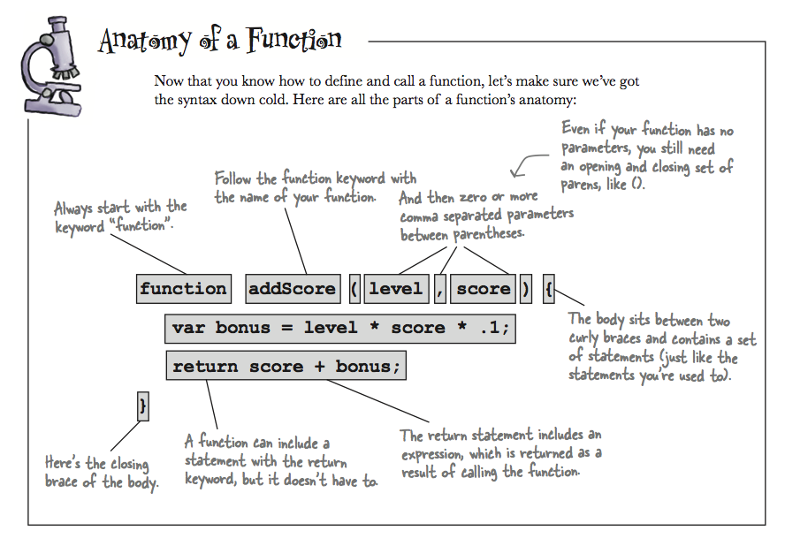

Slide 32
Functions that return a value
Add the following code to displayScript.js. What does it do?
function returnValue(){
var greeting = "Hello from returnValue";
return greeting;
}
console.log(returnValue());

Slide 33
Return Values are important to understand
Say we have a function called myFunc that returns the string “hello.”
Say we create a variable called myFuncValue and set it equal to the return value of myFunc like this: var myFuncValue = myFunc();
Then we do this:
console.log(myFuncValue + “JavaScript”);
What is logged?

Slide 34
Concatenation
We can combine two strings using the plus (“+”) operator.
Add this code to displayScript.html.
var stringOne = "Our powers ";
var stringTwo = "combined!";
console.log = stringOne + stringTwo;

Slide 35
Exercise: Displaying a return value
1.In this exercise we’ll display the return value of a function in our web page.
Add the following code to displayScript.js. What does it do?
var displayString = "<h1>"+returnValue()+"</h1>";
display.innerHTML = displayString;
Try using the Chrome Dev Tools to inspect your web page. What does it show in the HTML?

Slide 36
Exercise: Tying it all together
Make a new webpage called my-first-app.html
Create a stylesheet for it and link it to your page
Create a JavaScript file for your app and link it to your page
Your app should be similar to the display.html page but use CSS to make it your own. Change colors, fonts, borders and background.
Write JavaScript that will display the text “My First JavaScript App” on your page. Use heading tags and CSS to make this text large and noticeable.

Slide 37
Exercise: Tying it all together Part II
1.Convert your first app so that the text you are displaying on your page comes from the return value of a function.
2. Log “all done!” to the console

Slide 38
Free Code Camp on JavaScript
Let’s head over to Free Code Camp and see if we can complete a few of their JavaScript exercises.
We’ll have to skip the Bootstrap and jQuery sections for now.

Slide 39
Homework
The Basic JavaScript curriculum at Free Code Camp is a good introduction to the topic.
Over the next two weeks, try to complete all of the basic JavaScript exercises.
Remember, getting stuck while coding happens to everyone. That doesn’t mean you’re terrible at JavaScript. It’s just a challenge to work through.
Tenacity > Talent.

Slide 40
Coming Up
In Session Five we’ll continue our introduction to JavaScript, and we’ll create a more complex application that accepts and processes user input.
Session Six will feature talks from local developers and CEOs. We’ll hear from the people who know about the realities of learning to code, the opportunities available to those who do, and what things you should watch out for.

Slide 41
Questions?

Slide 42
Code on!

